Slide 1
Roommates Match System
By Jiyang Li

Slide 2
Overview
Start from a static web
Set up new account
Search
Update info
These three operation will be executed by Ubuntu Hosting in EC2
Data is stored in AWS RDS

Slide 3
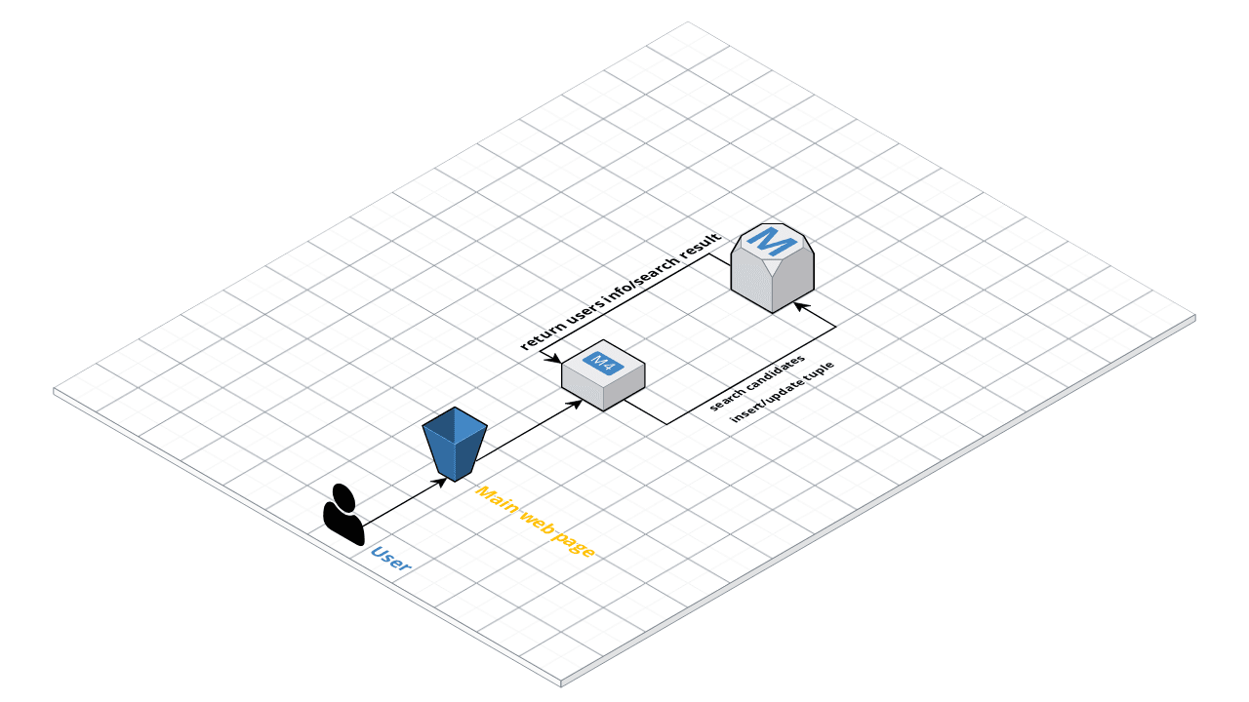
Diagram

